Slide 1
2.2 Normal Distribution

Slide 2
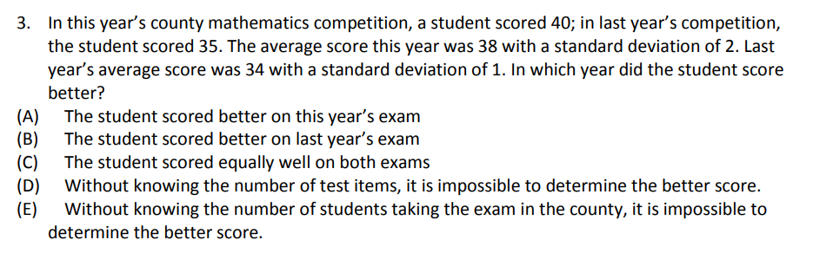

Slide 3



What is a Normal Distribution?
A population is normally distributed if it is distributed according to the
68 – 95 – 99% rule
  Ie: If we move ONE standard deviation above and below the mean, we will encompass 68% of all the data points
  Ie: If we move TWO standard deviation above and below the mean, we will encompass 95% of all the data points
  Ie: If we move THREE standard deviation above and below the mean, we will encompass 99.7% of all the data points
0.3% of observations will
be outside of 3σ of the mean
x
0

Slide 4
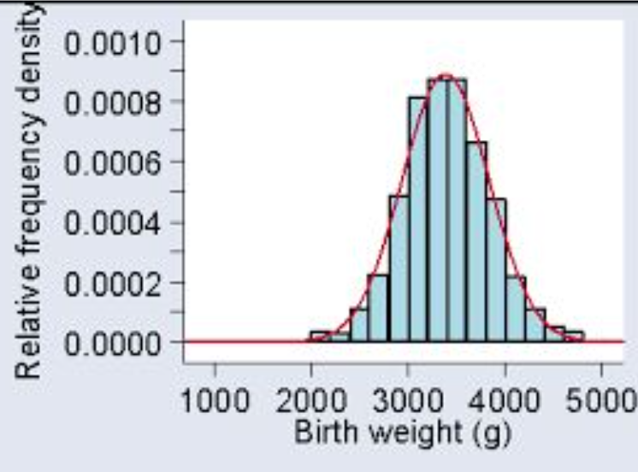
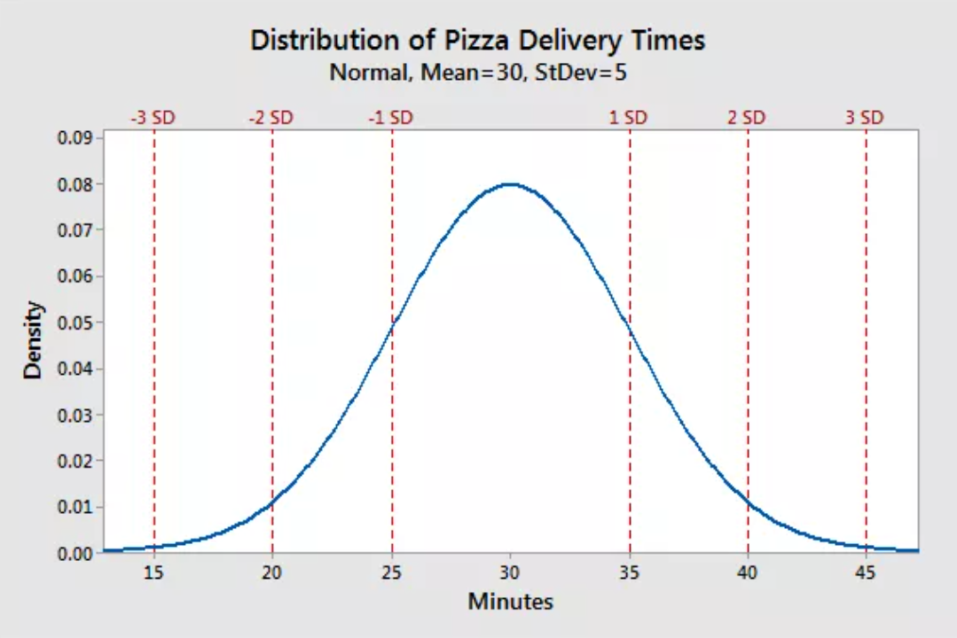
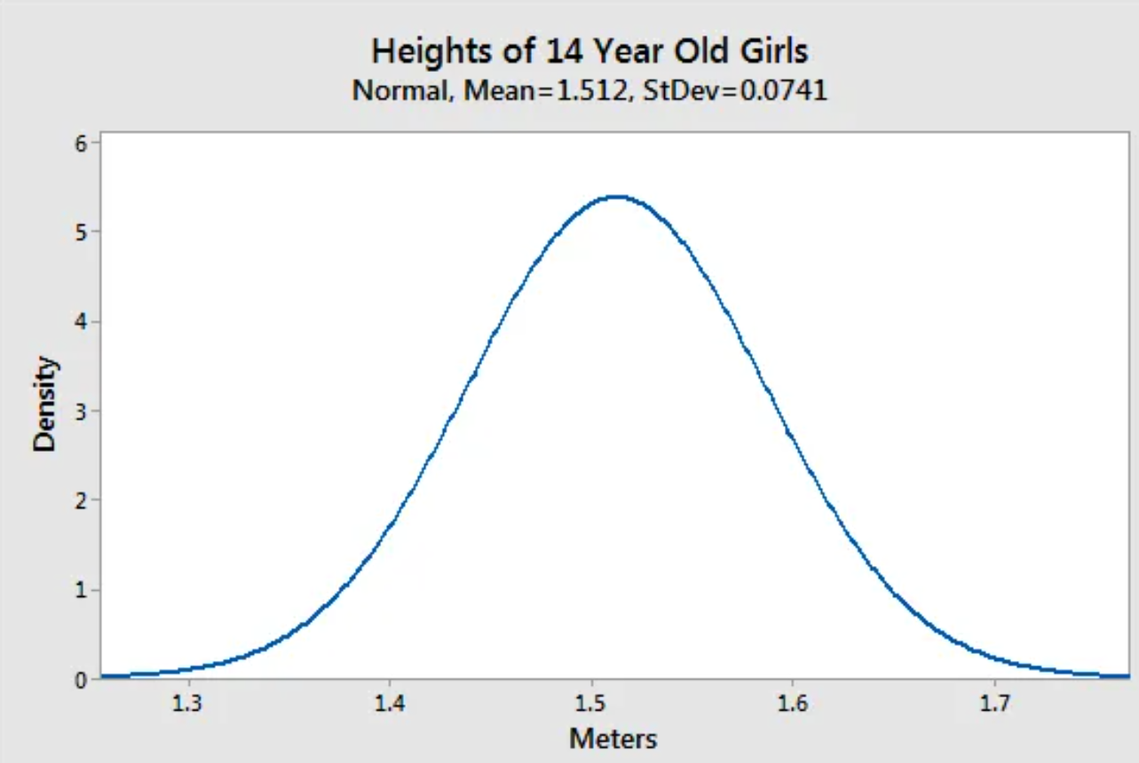
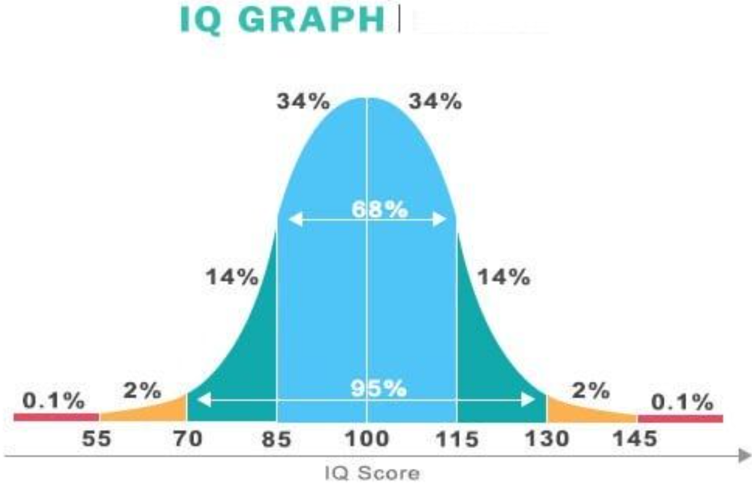
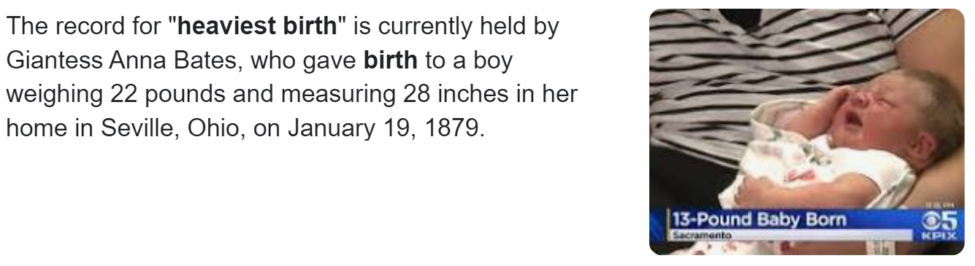
Example of Normal Distribution:
Here are example of things that are normally distributed:
Average weight of a new born baby is about 3.5kg. (7.5lbs) Most babies are between 2.5kg (5.5lb) to 4.5kg(10lbs)
The average IQ score is 100. 115 is considered really smart. A genius has an IQ of 160. higher than 99.99% of the population.
Most 14 yr females have a mean height of 1.51meters tall. Majority of them are give or take about 10cm
This study was done in the states. How long would it take to get your pizza delivered. Average time was 30min. Most them where between 20 to 40 minutes.
Link to Distribution fish Sizes

Slide 5
Which of these events do you think are normally distributed?
i) The average weight of 5 year old boys YES or NO
ii) The month which HS students are born in YES or NO
iii) The number of years an iphone is used YES or NO
until it begins to slow down
iv) The heights of female students between YES or NO
the ages of 16 to 18
YES, avg weight of boys is abt 40lbs (center)
There is no average month. (Month is categorical)
Most phones have an average lifespan. For iphones, it’s about 4yrs, 3 months.
Most girls peak at 15yrs old. By 16 to 18 their hts are set. So we will likely have an average height.

Slide 6
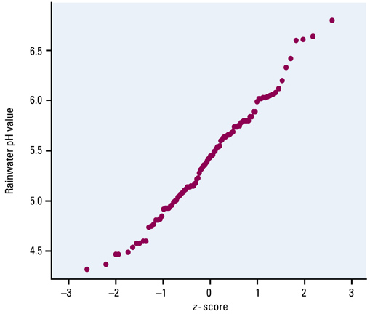
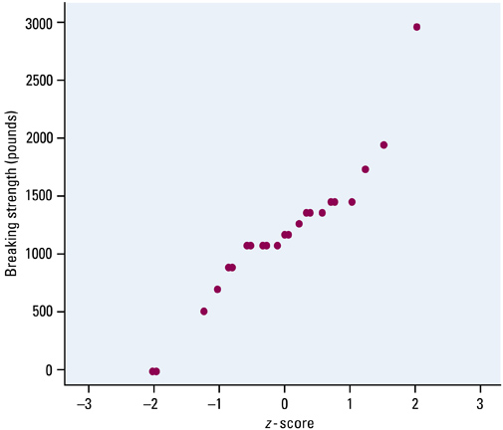
How to Check if Data is Normally Distributed?:
When we have a data set, we want to check if the population is normally distributed:
Method 1: Draw a histogram → bell-shaped, 68-95-99.7
Method 2: Draw a “Normal Probability Plot”
  Compares data points on one axis vs corresponding “z’ scores on the other axis
  Most of the data will be on a straight line
  If the largest observations deviate from this line → data is skewed right
  If the smaller observations deviate from this line → data is skewed left
Relatively straight,
so this data is
suitable for using a
normal distribution
Larger observations deviate from the line, data is skewed right, so this data is NOT
Normal

Slide 7
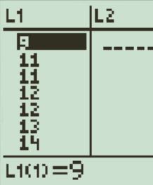
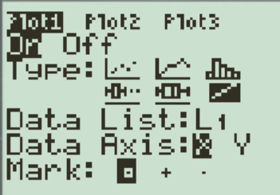
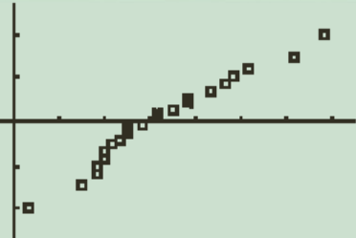
Using Ti-83 TO make Normal probability plot
First type all the data values in L1
  Stats → Edit → “type data in L1”
Then go to Stats Plot and select the plot shown below:
  “2nd” → Y= → Select the 6th plot → Data L1 → “X’ axis
Graph the data: “x” axis is the data and “Y” axis will be the corresponding Z scores “aka Standardized Test Scores
  ZoomStat #9
Draw the line crossing through most of the points, check for deviations on the left (small observations) and right side (large observations)

Slide 8
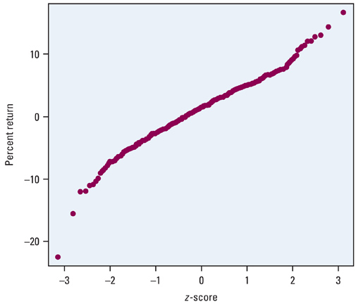
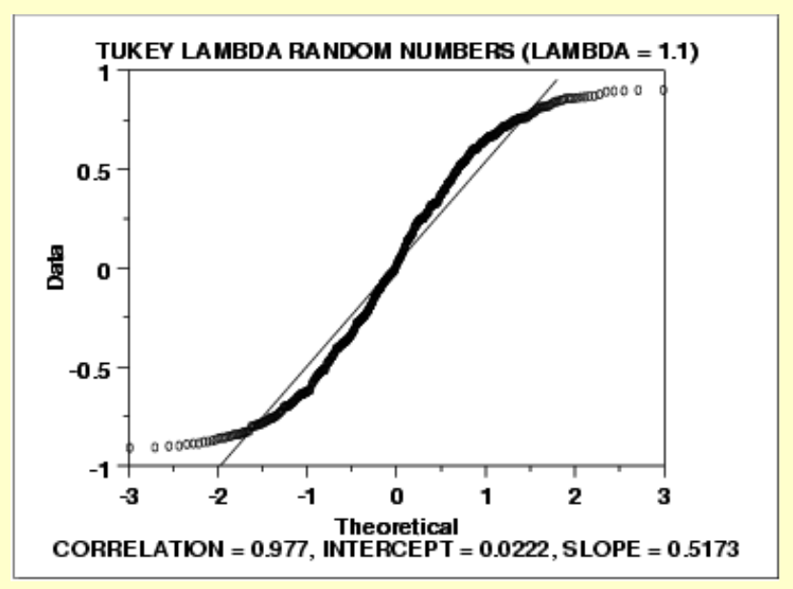
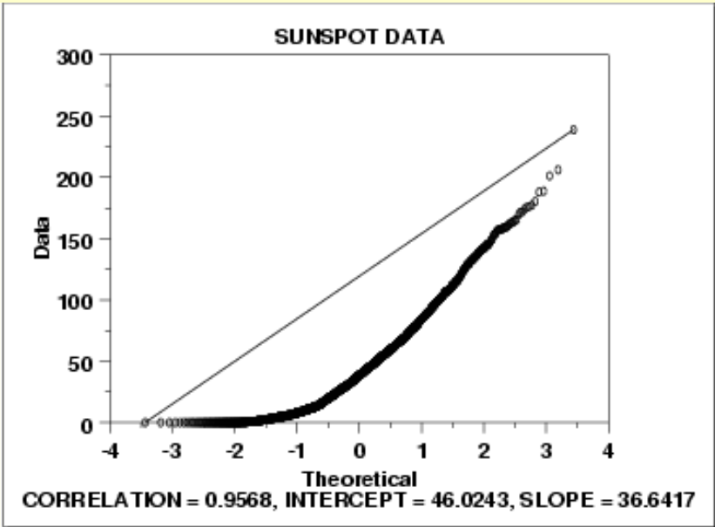
Interpreting Normal probability plots
If the observations from our sample yields a normal probability plot that is linear → this suggests that the population is normally distributed
Most of the observations are on a straight line, this suggest that the population is Normally Distributed
A plot that curves upwards indicates a long tail to the right
An “S” shaped curve indicates shorter than normal tails, meaning less variance than expected

Slide 9
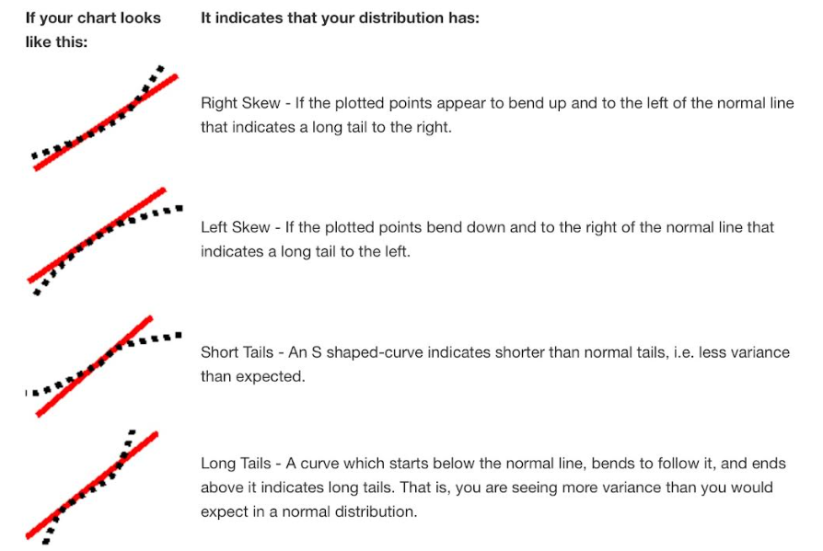

Slide 10
Q: The following data reflects the percentage increase in milk prices from 38 stores in the past 6 months.
i) Create a normal probability plot and indicate whether if the percentage increase in milk prices is normally distributed:
ii) Create a Histogram and check if the data is skewed or normal
iii) Is the increase in milk prices in the last 6 months normally distributed?
5
6
4
13
15
17
18
12
15
14
22
24
25
26
27
23
25
26
29
35
36
38
33
34
35
36
41
43
45
49
47
45
42
55
57
65
85
98

Slide 11
Ex: Given the set of data, indicate whether if they are normally distributed, skewed left, right, bimodal by making a Normal Probability Plot
Data Set #1:
5, 5, 4, 7, 8, 6, 9, 7, 6, 10, 11, 9, 5, 3, 4, 13, 11, 9, 8, 7, 6,
Data Set #2:
10, 13, 25, 23, 21, 16, 18, 22, 23, 16, 21, 22, 25, 26, 29, 28, 17
Data Set #3:
31, 49, 47, 45, 44, 42, 33, 45, 44, 35, 31, 30, 32, 34, 26, 37, 36, 41, 43,

Slide 12
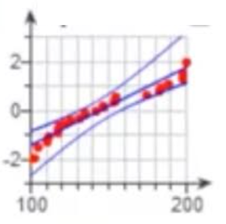
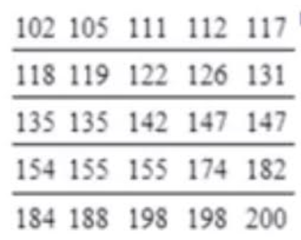
Q: Suppose the data represents the numbers of candies in 25 different 4oz candy bags. Use the given normal probability plot to determine if the data could have come from a normal distribution:
The relationship is NOT linear, so the sample data could not have come from a population that is normally distributed
The relationship is NOT linear, so the sample data could have come from a population that is normally distributed
The relationship is approximately linear, so the sample data could not have come from a population that is normally distributed
The relationship is approximately linear, so the sample data could have come from a population that is normally distributed

Slide 13
Normal Distribution
Normal Distributions centers at the average, with the rest of the data spreading out like a bell curve
  Ie: Test scores, biological characteristics: Height, weight, length, probability distributions
Most data can be standardized into a normal distribution that can be used to calculate the “percentile” of any observation
μ: Mean, average of the distribution
: Standard Deviation – gives the spread of the data
“Standard Normal Distribution” → N(0,1) [µ = 0; σ = 1]
  For a standard normal distribution, the mean is 0 and the st Dev is 1.
Ball Dropping Applet

Slide 14
Properties of Normal Distributions
A continuous, symmetric, bell-shaped distribution of a variable
Symmetric about the center → Mean, median, and mode are in the middle at the peak
The total area under the curve is equal to 1. So 100% of all continuous random variables fall under the curve
The two tails continue in both directions, never touching the X-axis, tail values are very small
The std dev. (σ) determines the width of the curve
The left graph has a greater spread than the right graph. So the st dev. Of the left graph is bigger than the right graph.
y
0
2
4
x

Slide 15
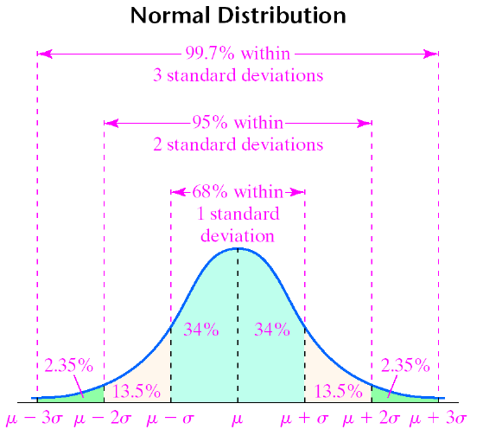
Q: What percentile are you at if you are 1 St dev. above the mean?
Q: What percentile are you at if you are 1 St dev. below the mean?
Q: What percentile are you at if you are 2 St dev. below the mean?
Q: What does it mean if your IQ is 3 st dev. above the mean?

Slide 16
Z-scores and Normally Distributed
If your variables ‘x’ are normally distributed with N(µ,σ), convert it to a standard normal distribution N(0,1)
Standardize any observation
‘x’ to find the Z-scores
Z-scores are used to locate how many standard deviations an observation ‘x’ is from the mean
The Standard Normal Table (Table A) gives only the LEFT area of the curve for any Z-score
y
0
x
Z-score Table

Slide 17
Ex: Find the proportions of observations from a normal standard distribution that fall within each region.
i) Use Table A iii) Normalcdf(a,b,µ,σ)
ii) ShadeNorm(a,b,µ,σ)
Z-score Table

Slide 18

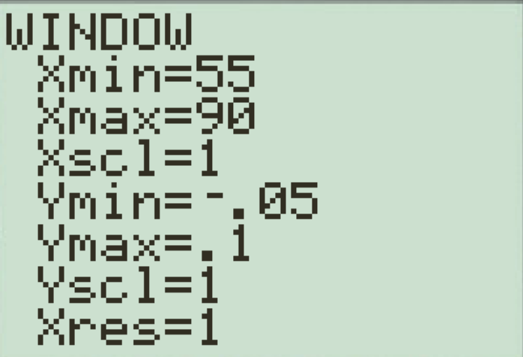
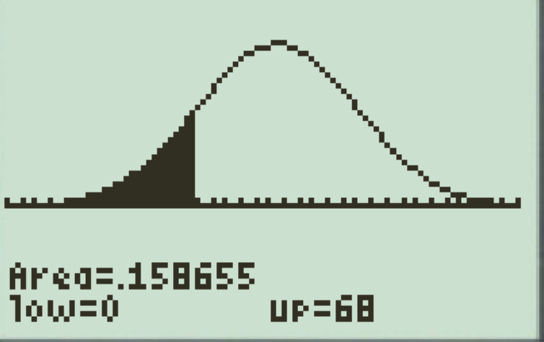
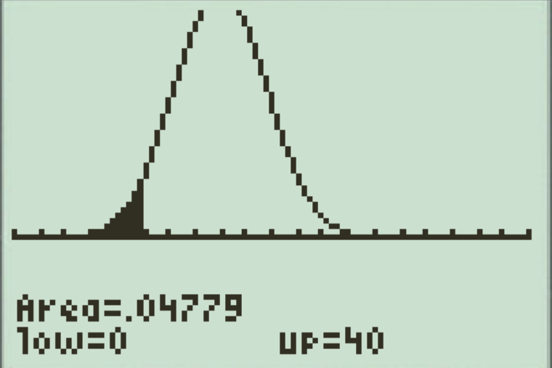
Ex: #1) The mean score of the final exam is 73.5% with a st dev. of 5.5%. Sally scored 68% on the final. What is her percentile?
Ex: #2) Mean height of 5yr old boys is 43” with st dev of 1.8”. Caleb is 40” tall, what is his percentile?
Ex: #3) The mean score of the pascal contest is 101 with a st dev. of 18. Sally scored 142 on the Pascal. What is her percentile?

Slide 19
Ex: For each standard normal distribution, Find the z-score with the given area (No Calculator)
y
0
x
y
x
0
Z-score Table

Slide 20
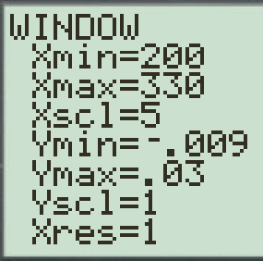
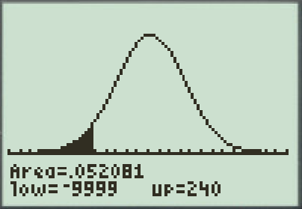
Ex: (P147 #2.33)The length of human pregnancies from conception to birth resembles a Normal Distribution with a mean of 266 days and a standard deviation of 16days. Find the following:
a) What percent of pregnancies last less than 240 days
b) What percent of pregnancies last between 240 to 270 days?
c) How long do the longest 20% of pregnancies last?
a) Solution: Find the z-score for 240 days
Alternative Solution: ShadeNorm
Use (Table A) to find the left area
for a Z-score of -1.63
Conclusion: About 5.2% of
pregnancies will last less
than 240 days
Z-score Table

Slide 21
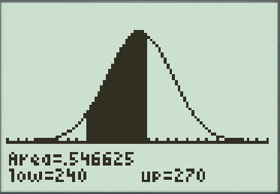
Find the Z-score of both observations
240 & 270
Alternative Solution:
If you use ShadeNorm, make sure
the previous diagram is cleared
Use Table A to find the left area of each Z-score
Subtract the area to
find the area in between:
Conclusion: About 55% of pregnancies
will last between 240 to 270 days
Z-score Table

Slide 22
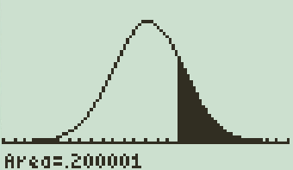
We are looking for the top 20% of pregnancies, then the right area will be 20% and the left area will be 80%. Use Table A to find the Z-score with the Left area from 80%.to 100%
Alternative Solution:
Use Inverse Norm to find the
value of the observation for 80%
to 100%
Use Table A to find the Z-scores
Use the Z-scores to find the
values of the observations
Conclusion: The longest 20% of
pregnancies will last between
279 to 342 days
Conclusion: The longest 20% of pregnancies will last between 279 to 320 days
Z-score Table

Slide 23
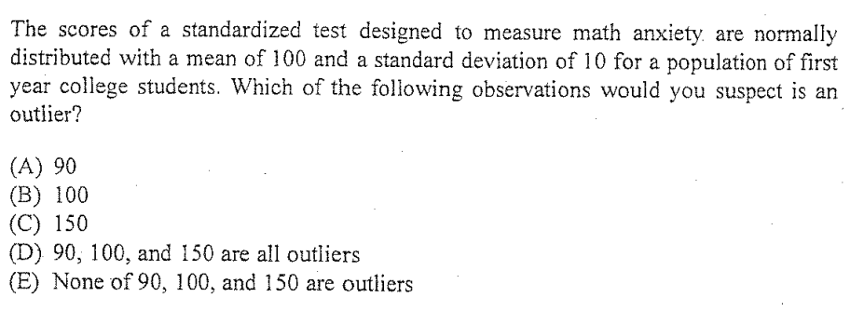

Slide 24
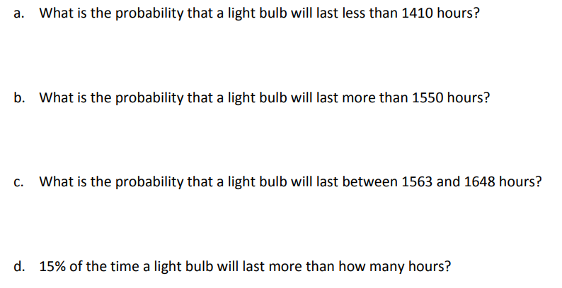

Slide 25
11.51% of the particular brand of light bulb will last less than 1410 hours
50% of the particular brand of light bulb will last more than 1550 hours
17.6% of the particular brand of light bulb will last between 1563 to 1648 hours
15% of the time a light bulb will last more than 1577.73 hours

Slide 26
This is the z-score for a LEFT area of 5%
The new mean would be 1323.36 hours
The new std dev would be 182.387 hours

